Slide 1
FR
AMIHACKS • ZERO HUNGER RESCUE PLATFORM
Turning surplus into smiles.
Good food shouldn't go to waste. Let's rescue it, together. Bridging commercial food surplus and community shelters in real-time.
Submitted by: CtrlElites
AmiHacks Finalist

Slide 2
PROBLEM STATEMENT
The Surplus & Discard Paradox
The Surplus Dilemma
The Discard Paradox
Traditional Inefficiencies
Massive generation of edible surplus food across commercial and institutional food service sectors.
Safe consumption food discarded due to absence of rapid redistribution channels.
Heavy reliance on manual coordination methods like phone calls and static spreadsheets.
Core Consequence: Avoidable food waste and diminished utilization of vital nutritional resources.

Slide 3
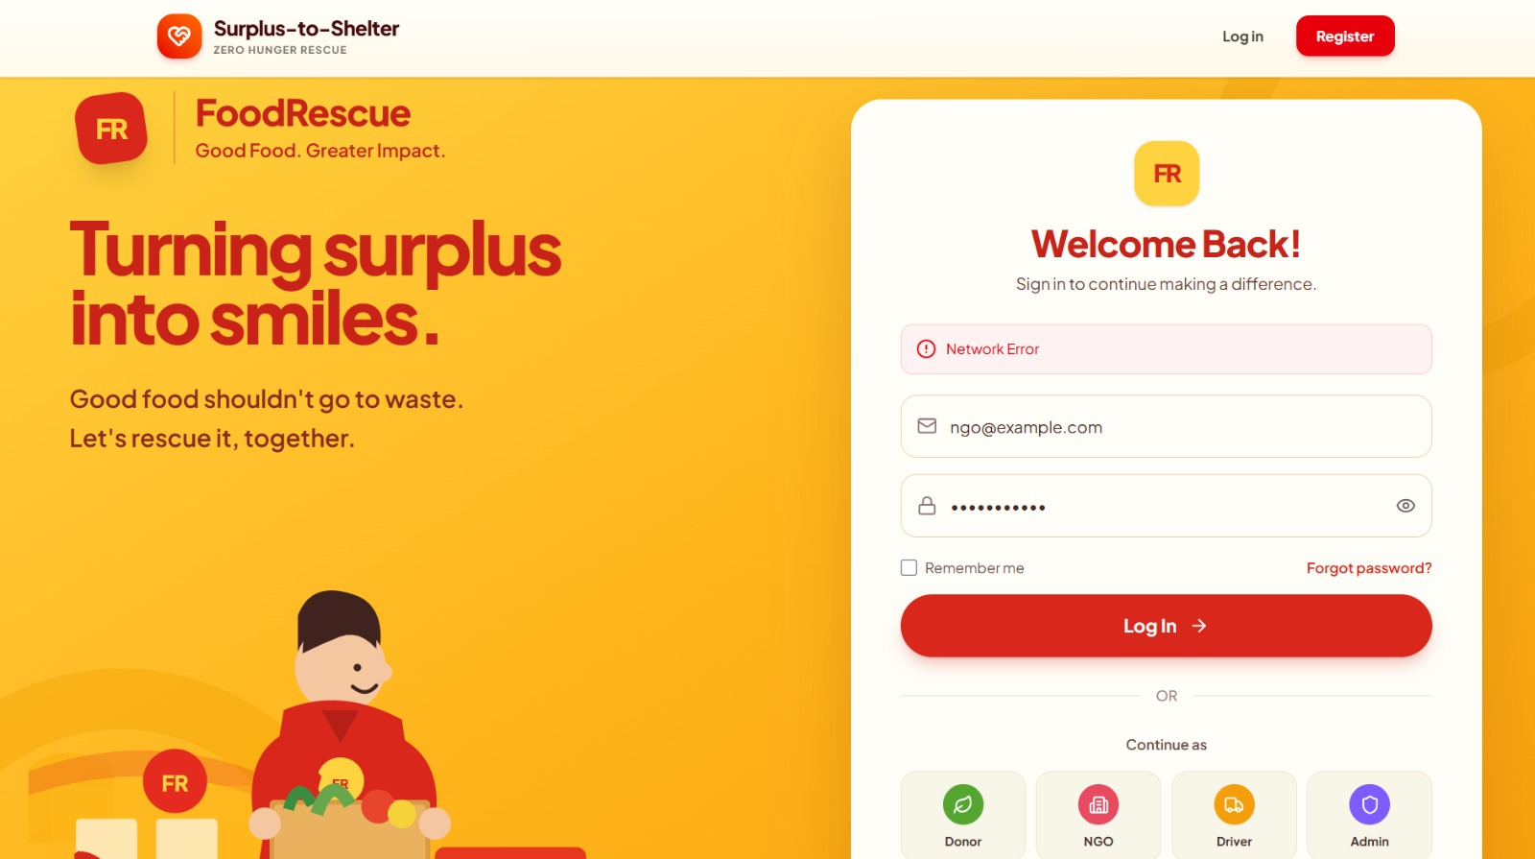


SYSTEM ARCHITECTURE
Multi-Actor Platform & Intelligent Intake
Integrated Ecosystem
Bridging Food Donors, Recipient Shelters (NGOs), and Volunteer Drivers into a unified digital workspace.
Compatibility Engine
Computes dynamic match scores evaluating distance, recipient storage limits, dietary compliance, and perishability urgency.

Slide 4
LOGISTICS & SECURITY
Event-Driven Lifecycle & Trust Framework
Transparent 8-Stage Lifecycle
Posted → Matched → Driver Assigned → En Route → Picked Up → In Transit → Delivered → Verified
Real-Time Streaming
Accountability & OTP
Socket.IO & Leaflet/OSRM integration for live driver location tracking and instant status notifications.
Secure organization credentials and OTP-based digital confirmation for safe handovers.

Slide 5
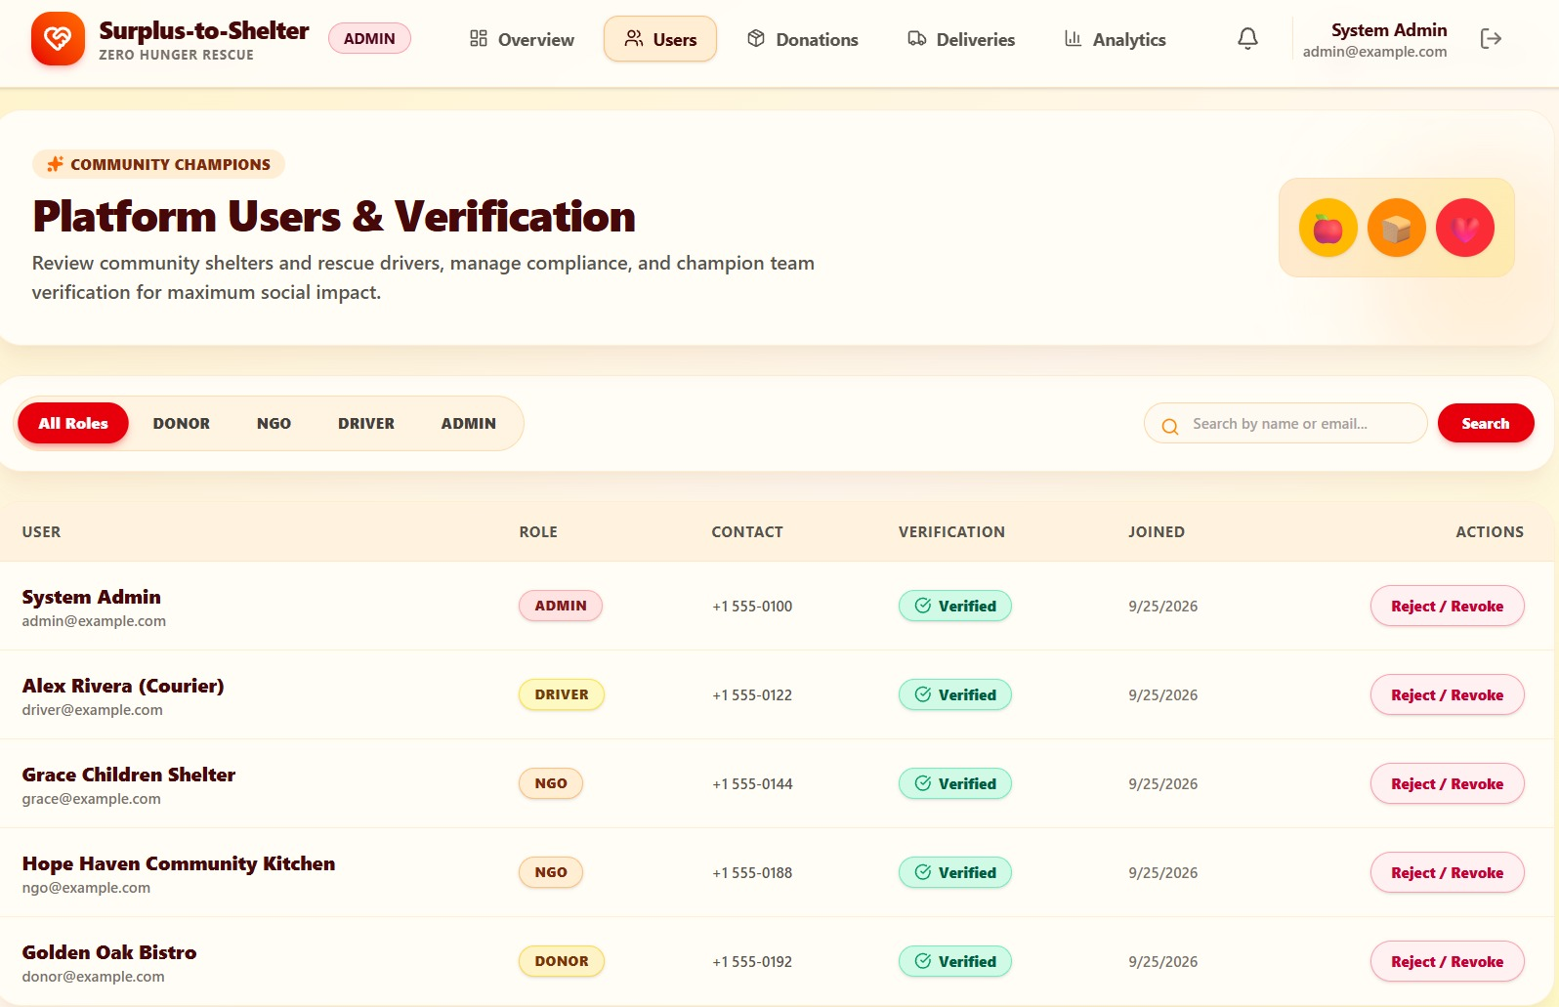
CORE FEATURES
Expiry Assessment & Smart Dispatch
Expiry & Urgency Engine
Classifies donations into LOW, MEDIUM, HIGH, and CRITICAL priorities, triggering automated escalations.
Smart Dispatch & Routing
Pairs donations with drivers by evaluating vehicle capacity, active job loads, and pickup feasibility via OpenStreetMap.

Slide 6
ADVANCED MECHANICS
Live Tracking & Failure Handling
Live GPS Streaming
Automated Re-Matching
Role-Based Dashboards
Drivers broadcast real-time coordinates via dedicated socket rooms for live map tracking on all dashboards.
Built-in fallback workflows automatically re-queue and re-match donations if an NGO rejects or driver cancels.
Customized operational views for Donors, NGOs, Drivers, and Admins secured via JWT endpoints.

Slide 7

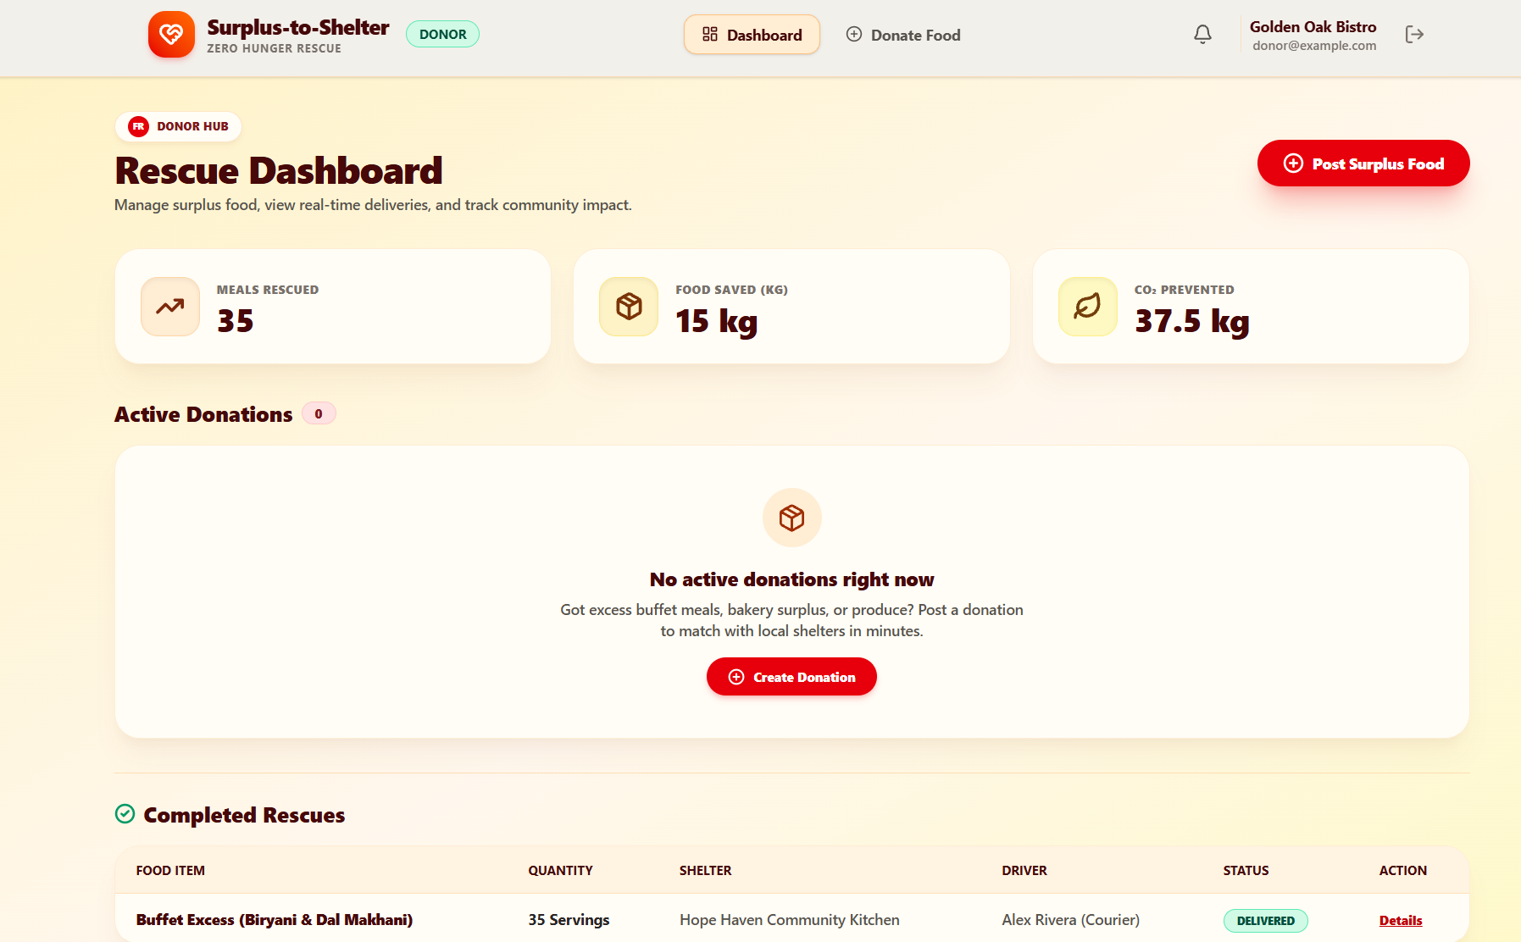
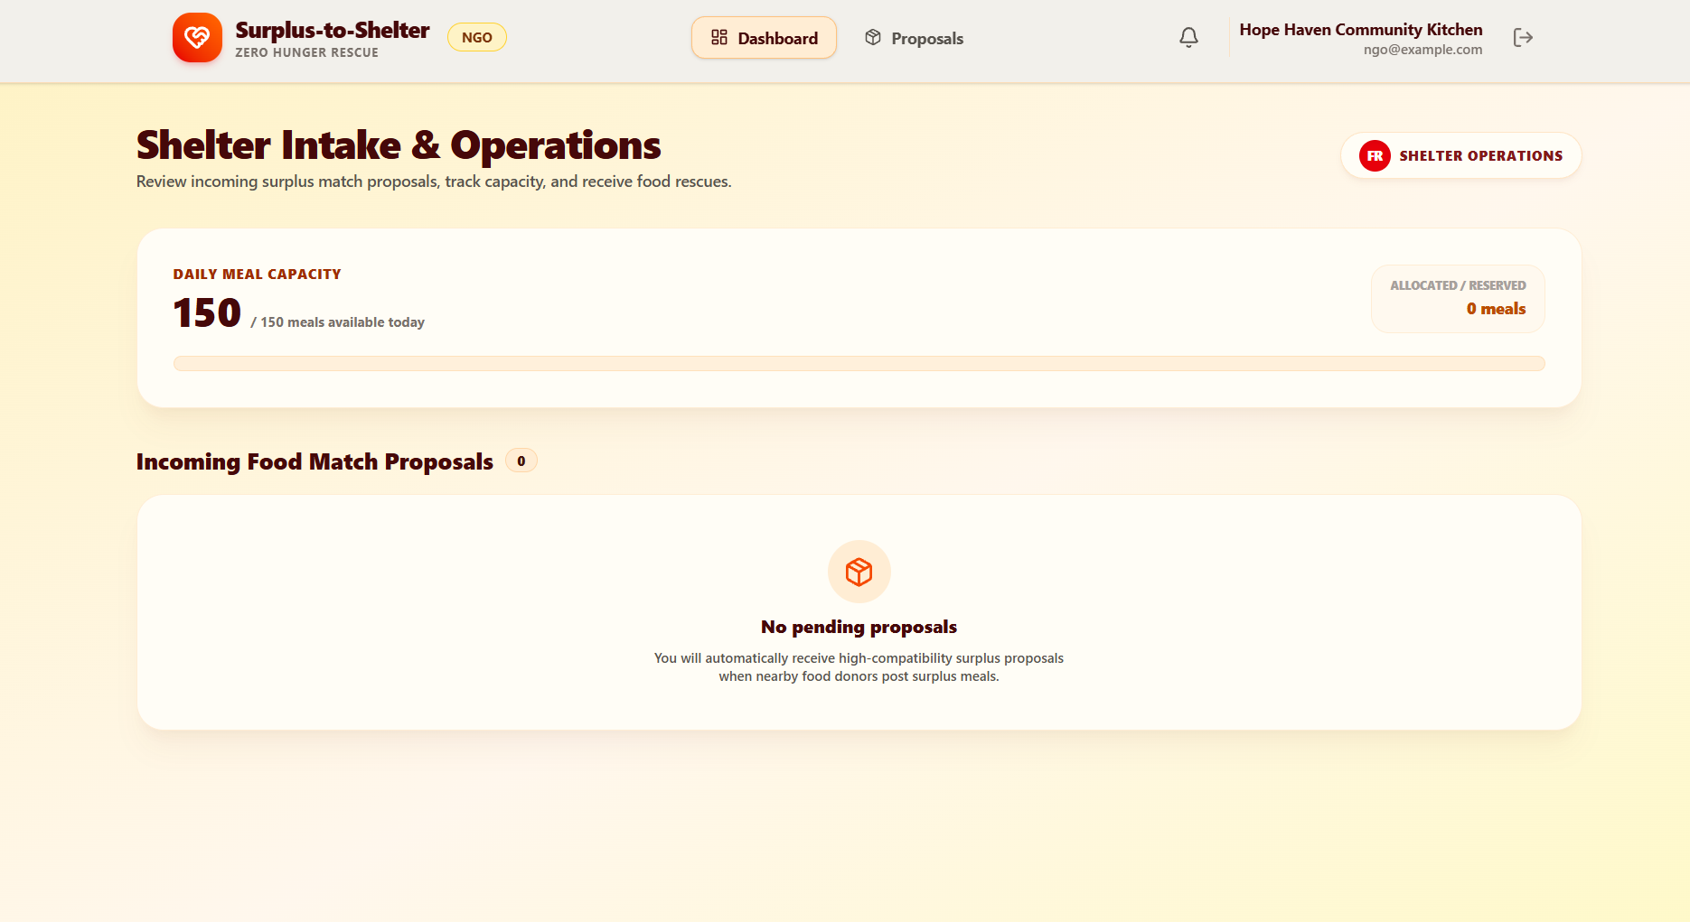
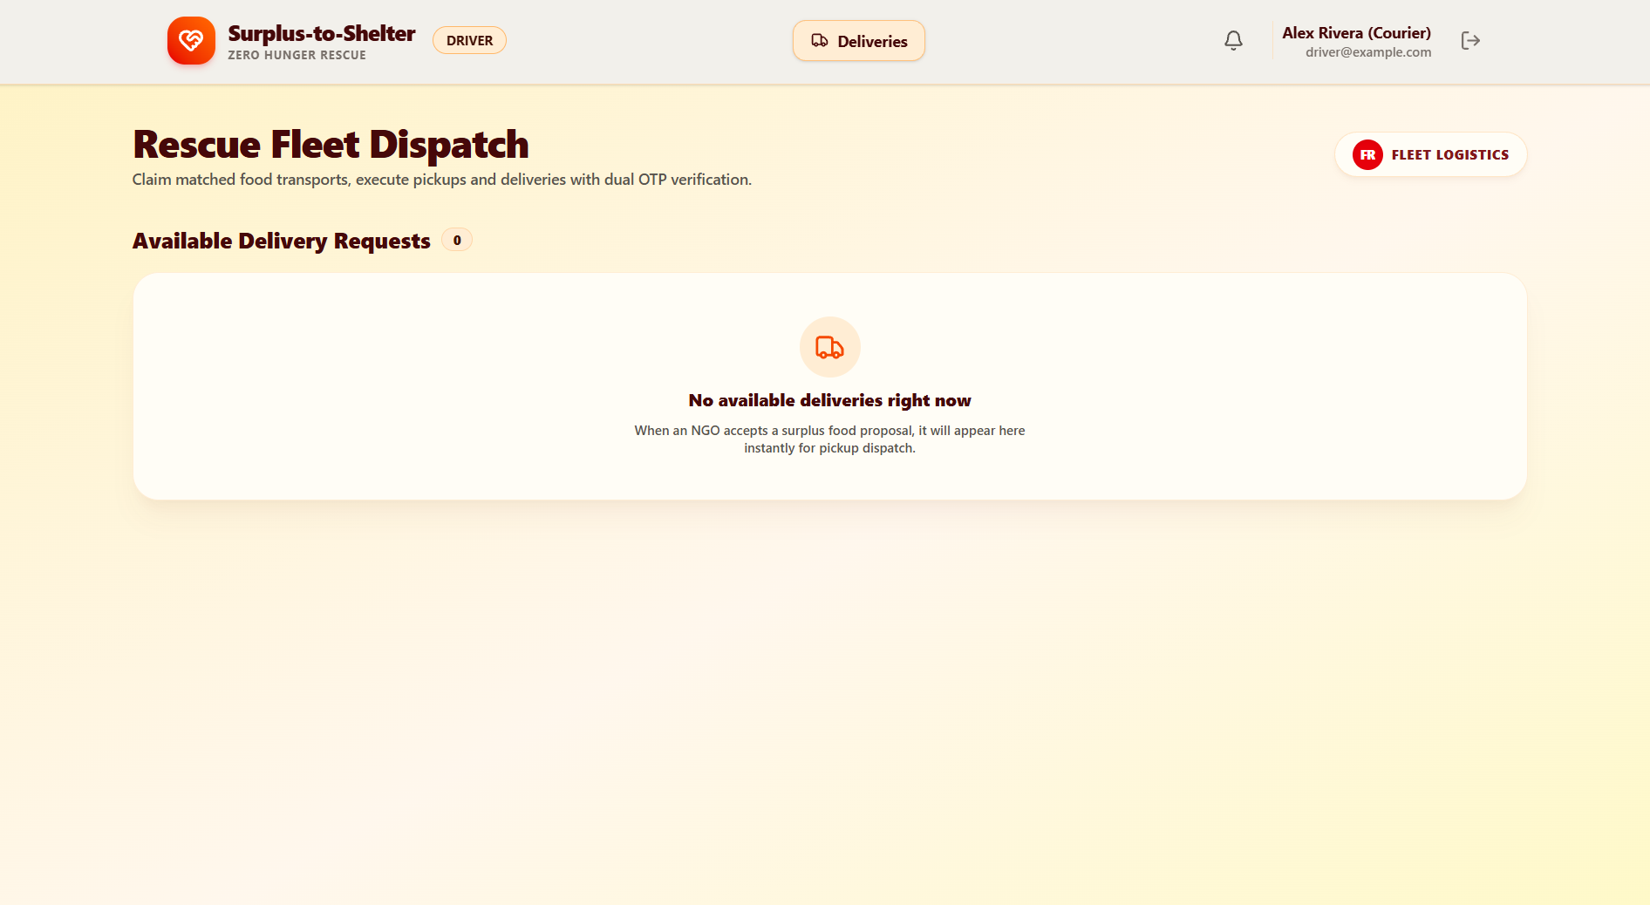
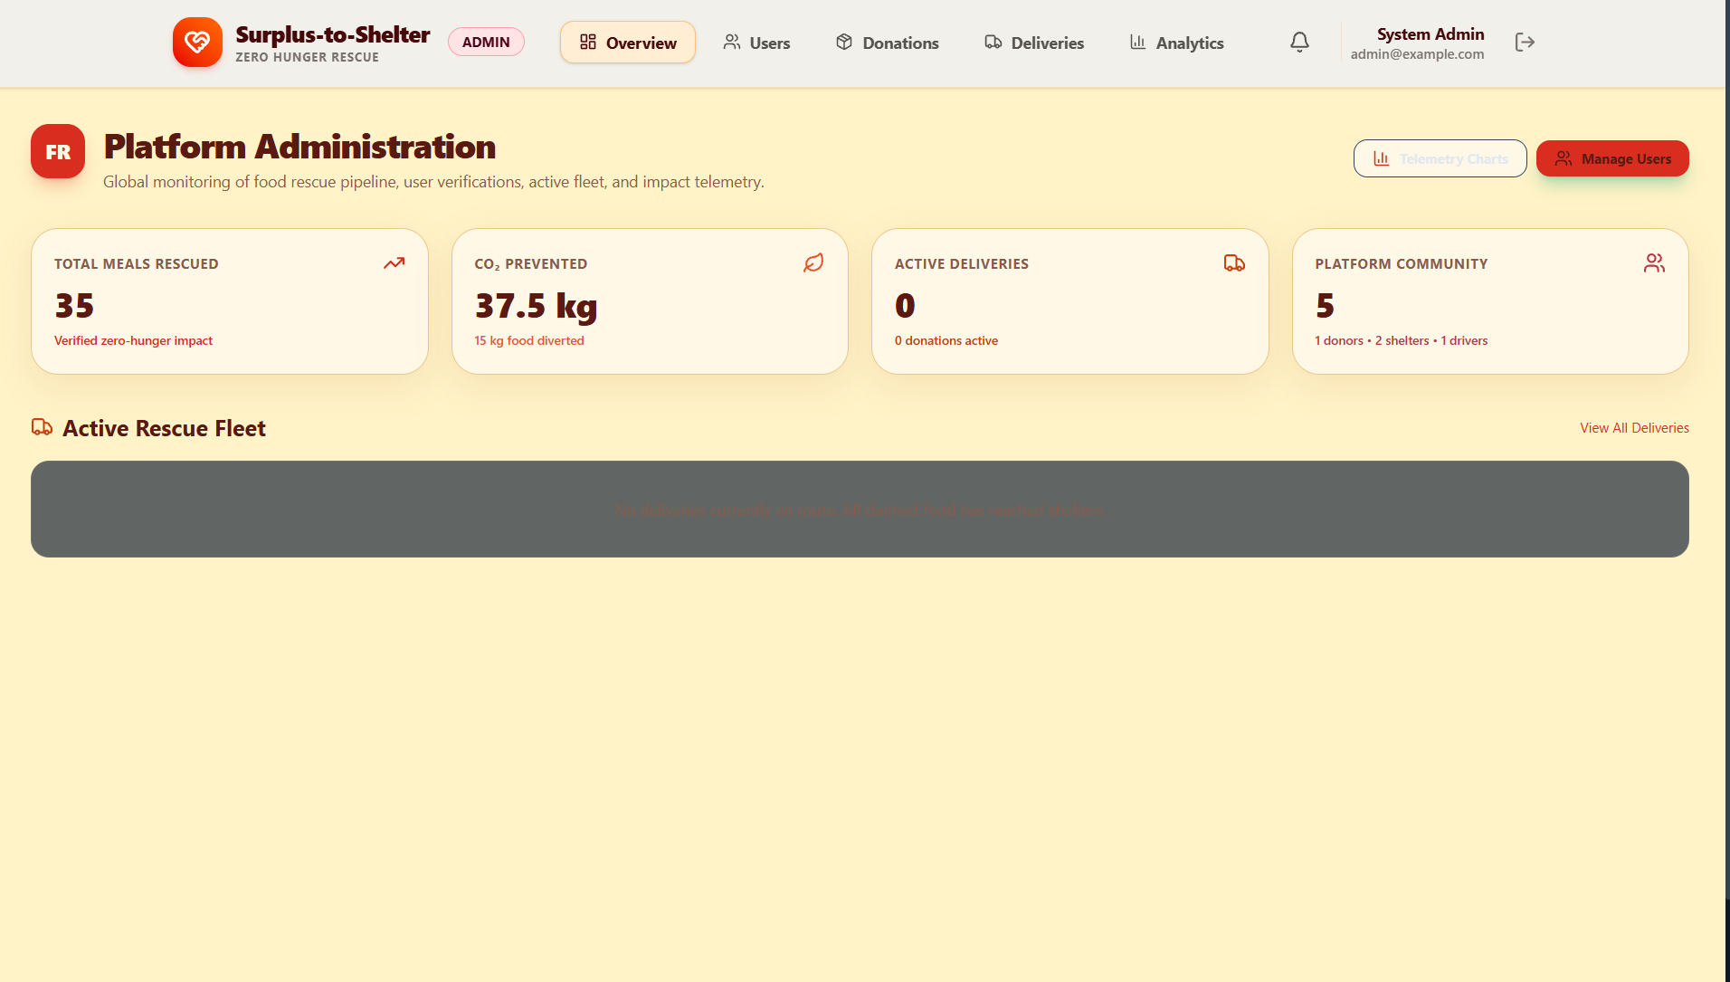
PLATFORM INTERFACE
Operational & Admin Dashboards
Donor Rescue & Fleet Dispatch
Admin Command & Shelter Intake

Slide 8
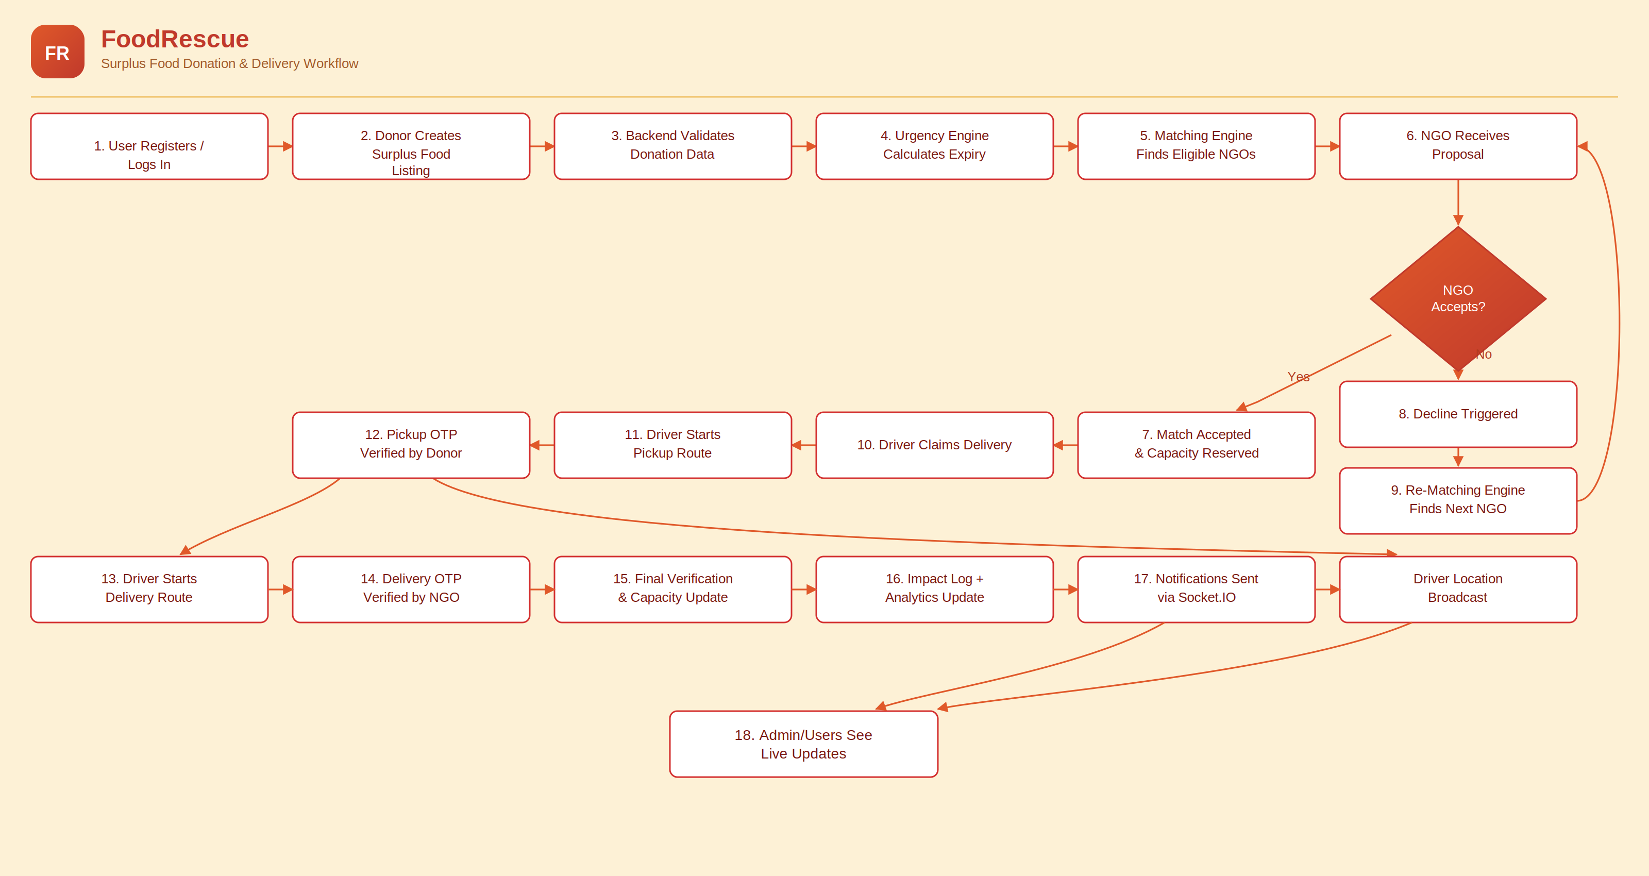
IMPACT ANALYTICS
Quantitative Monitoring & Telemetry
Impact Assessment Dashboard
Tracks total food rescued (kg), estimated meals supported, active user counts, and CO2 diversion metrics.
Environmental Conversion
Documented conversion models (e.g., 1kg food = 2.5kg CO2 avoided) to quantify direct landfill diversion impact.

Slide 9
ROADMAP
Future Scope & Next-Gen Innovations
Driven Demand Forecasting
Predictive Driver Positioning
Image Food Classification
Leverage historical trends to predict surplus volumes & bottleneck hours.
Recommend staging zones in high-surplus districts to minimize response time.
Computer vision models for automated category & volume bracket detection.
Multi-Stop Routing (VRP)
IoT & Cold-Chain Monitoring
Scale & Impact
Upgrade to route solvers (Google OR-Tools) for multi-donor pickups.
Real-time temperature telemetry for strict food safety compliance.
Expanding zero-hunger rescue nationwide.

Slide 10


Thank You
Empowering communities, eliminating food waste, and nourishing the future with Surplus-to-Shelter.
CtrlElites • AmiHacks Presentation

